Slide 1
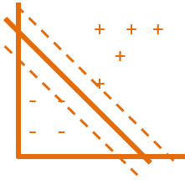
Support Vector Machines
Simple algorithm with a clever trick
Yordan Darakchiev
Technical Trainer
iordan93@gmail.com

Slide 2
sli.do #MachineLearning

Slide 3
Table of Contents
Support vector machines
Kernel trick
k-nearest neighbors
Anomaly detection and outlier detection

Slide 4
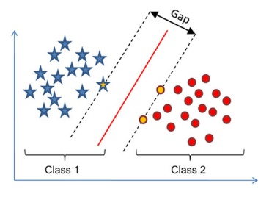
Support Vector Machines
Extreme(ly easy) case
Two linearly separable classes
Decision boundary: simple line (plane in many dimensions)
Goal
Choose the line that best separates the classes
Maximum margin
The math formula for the objective function is a little complex because it involves matrix algebra
Applications:
Mainly for classification
sklearn.svm.SVC, LinearSVC
Regression: sklearn.svm.SVR

Slide 5
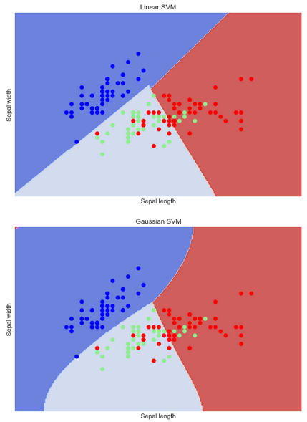
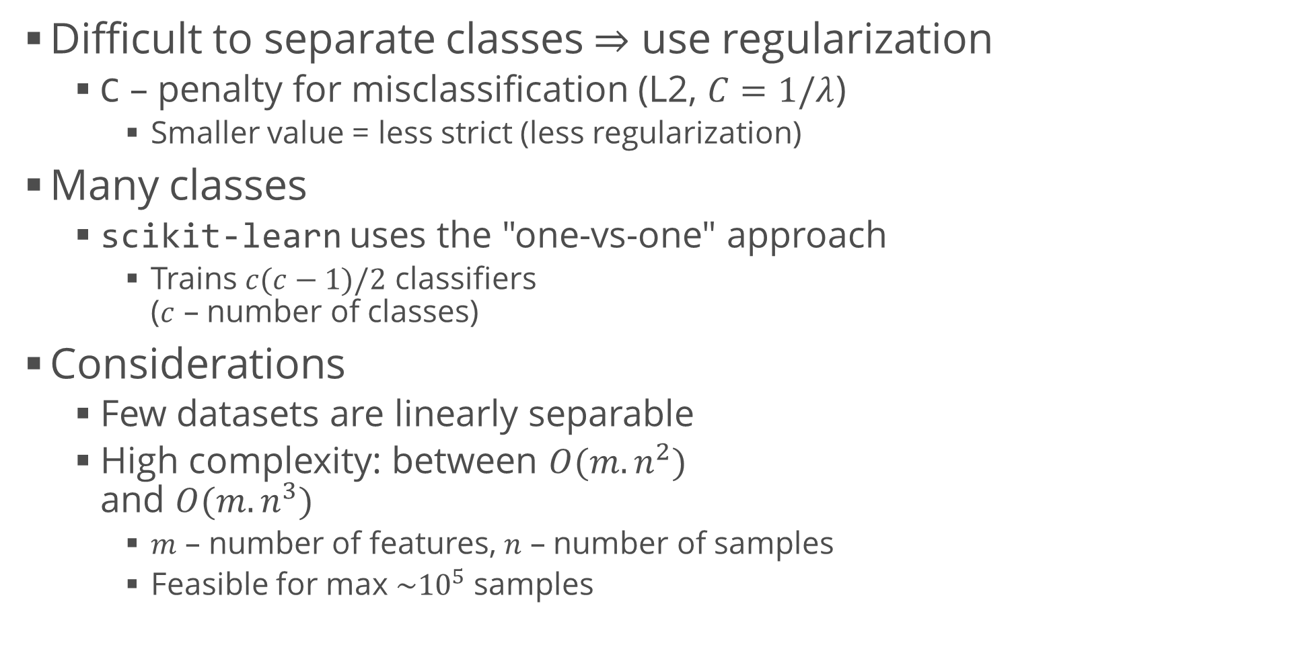
Support Vector Machines (2)
Difficult to separate classes $⇒$ use regularization
C – penalty for misclassification (L2, $C=1/λ$)
Smaller value = less strict (less regularization)
Many classes
scikit-learn uses the "one-vs-one" approach
Trains $c(c−1)/2$ classifiers ($c$ – number of classes)
Considerations
Few datasets are linearly separable
High complexity: between $O(m.n^{2})$ and $O(m.n^{3})$
$m$ – number of features, $n$ – number of samples
Feasible for max $\sim {10}^{5}$ samples

Slide 6
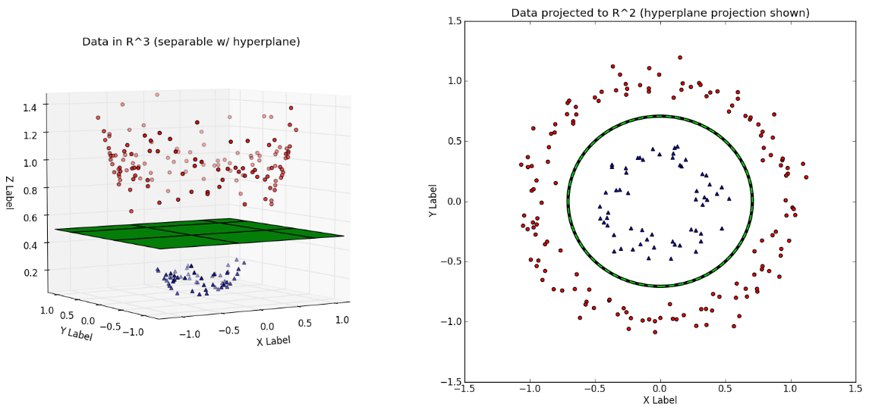
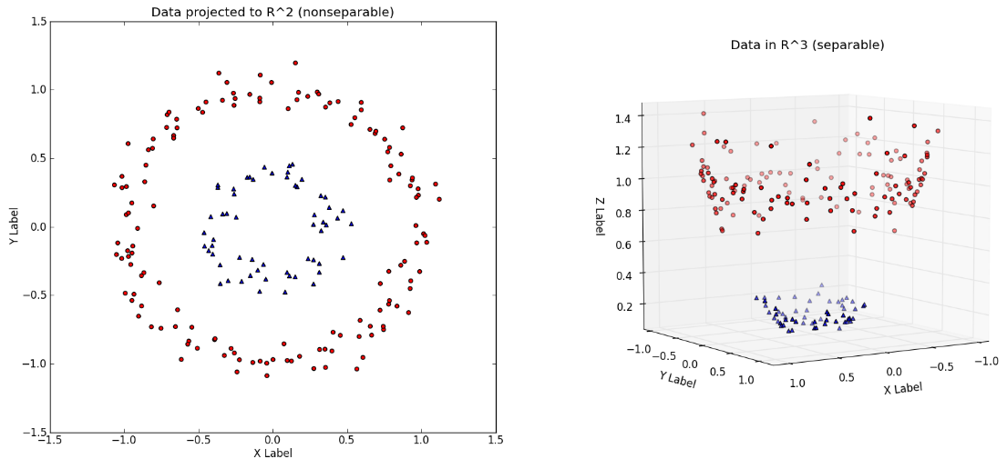

"Kernel Trick"
Used when data is not linearly separable
Algorithm
Create non-linear combinations of the features using a mapping function (kernel)
This projects them to a higher-dimensional space
Most widely used: Radial Basis Function (Gaussian) kernel
Hyperparameter $γ$ – needs to be optimized (e.g. via grid search)

Slide 7
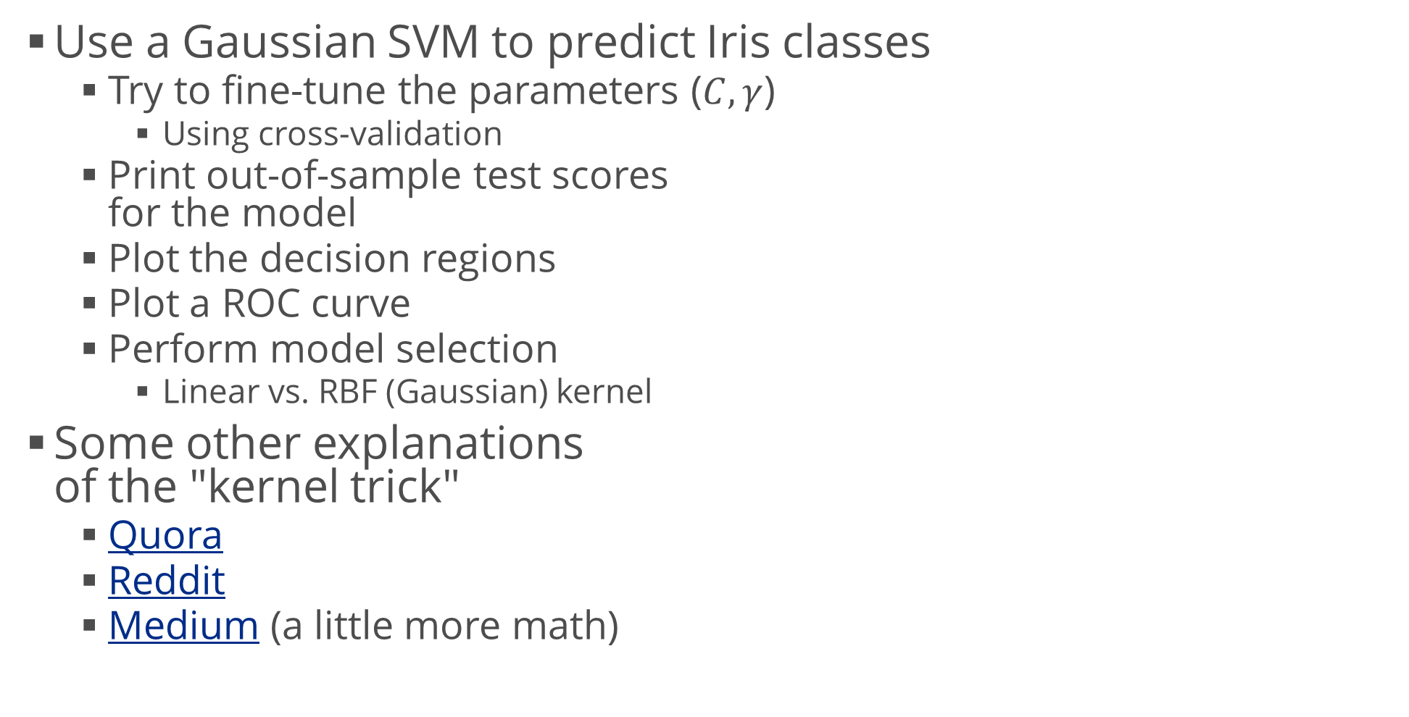
Example: Kernel SVM
Use a Gaussian SVM to predict Iris classes
Try to fine-tune the parameters ($C, γ$)
Using cross-validation
Print out-of-sample test scores for the model
Plot the decision regions
Plot a ROC curve
Perform model selection
Linear vs. RBF (Gaussian) kernel
Some other explanations of the "kernel trick"
Quora
Reddit
Medium (a little more math)

Slide 8
k-Nearest Neighbors
"Lazy learning"

Slide 9
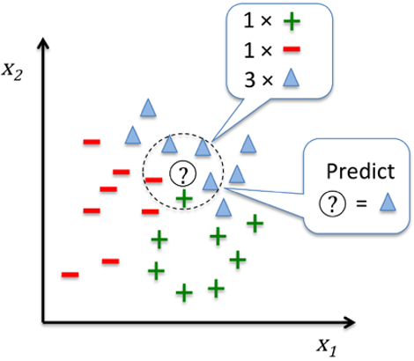
k-Nearest Neighbors (kNN)
"Lazy learner"
Doesn't learn a fitting function but memorizes the training data
Algorithm
Choose a number k and a distance metric (e.g. Euclidean)
This choice provides bias / variance balance
Minkowski distance: generalized Euclidean distance
Find the k nearest neighbors of the current sample
Use majority vote to classify
Advantage: easily adapts to new data
Downside: computational complexity grows linearly with new samples
Efficient implementation: k-d trees

Slide 10
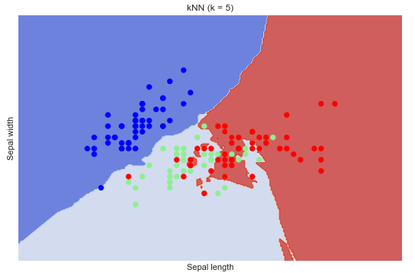
Example: k-Nearest Neighbors
Perform kNN on Iris data
It can also be used for regression
We need to be extremely careful, especially in the case of extrapolation
Display the decision regions
Voronoi tiling (tessellation)
Very useful in image processing and working with graphs
Can also be used for regression
Docs (scikit-learn)
from sklearn.neighbors import KNeighborsClassifier
knn = KNeighborsClassifier(n_neighbors = 5)
knn.fit(iris.data, iris.target)
knn = KNeighborsClassifier(n_neighbors = 1)

Slide 11
Anomaly Detection
Using SVMs to find unusual data

Slide 12
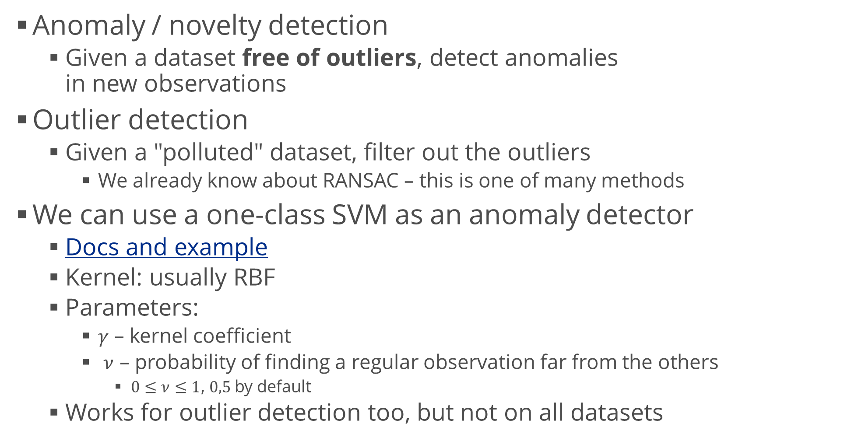
One-Class SVM
Anomaly / novelty detection
Given a dataset free of outliers, detect anomalies in new observations
Outlier detection
Given a "polluted" dataset, filter out the outliers
We already know about RANSAC – this is one of many methods
We can use a one-class SVM as an anomaly detector
Docs and example
Kernel: usually RBF
Parameters:
$γ$ – kernel coefficient
$ν$ – probability of finding a regular observation far from the others
$0≤ν≤1$, $0,5$ by default
Works for outlier detection too, but not on all datasets

Slide 13
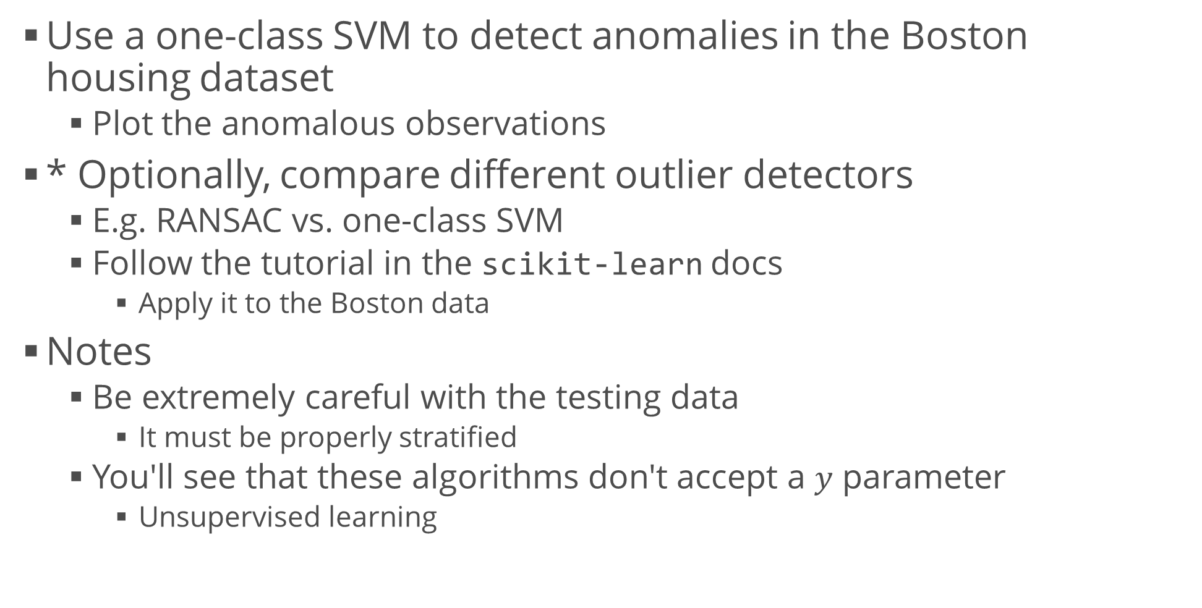
Example: Outlier Detection
Use a one-class SVM to detect anomalies in the Boston housing dataset
Plot the anomalous observations
* Optionally, compare different outlier detectors
E.g. RANSAC vs. one-class SVM
Follow the tutorial in the scikit-learn docs
Apply it to the Boston data
Notes
Be extremely careful with the testing data
It must be properly stratified
You'll see that these algorithms don't accept a $y$ parameter
Unsupervised learning

Slide 14
Summary
Support vector machines
Kernel trick
A mathematically rigorous tutorial (Microsoft)
k-nearest neighbors
Anomaly detection and outlier detection

